Slide 1

AN INTRO TO
Responsive Design
An introductory guide to responsive web design and how to succeed at it
DWAYNE MCGOWAN
VP SALES AND MARKETING, CONTENSIVE
A Publication of

Slide 2
TABLE OF CONTENTS
Chapter 1–Why Optimize for Mobile
Chapter 2–Why Responsive
Chapter 3 –Considerations for Responsive
Chapter 4 –Avoiding Mistakes
Chapter 5—Measure, Analyze and Adjust
Conclusion
f
t
in

Slide 3

CHAPTER
1
Why Optimize for Mobile
Joseph Van Os
UN states more people on earth have access to cell phones than working toilets.

Slide 4

Why Optimize for Mobile?
Just the facts – Jack!
There are 2.1 billion mobile broadband subscriptions globally
45% of American adults own a smart phone
31% of Americans use the smart phone more than their computer
American adults spend an average of 1.4 hours per day surfing the web on a mobile device
64% of adult Americans use their smart phone to get news
61% of mobile device users will leave a site if it is not optimized for mobile
Computer sales have peaked while smart phone sales are increasing exponentially
f
t
in

Slide 5

CHAPTER
2
Why Responsive Design

Slide 6
Why Choose Responsive?
flexibility, low maintenance, rapid launch
Responsive web design (RWD) optimizes the user experience across different screen sizes without the need to create multiple websites. With flexible grid based templates, CSS, HTML5 and JavaScript, a responsive site automatically adjusts images, templates, navigation and content according to the screen size of the device that is requesting the page.
1
A responsive site allows you to use a single URL for your content, making it easier for your users to interact with, share, and link, plus a single URL for the content helps Google's algorithms assign the indexing properties for the content.
No redirection is needed for users to get to the device-optimized view, which reduces loading time. Also, user agent-based redirection is error-prone and can degrade your site's user experience.
2
f
t
in

Slide 7
“
With today’s users experiencing almost every website on a variety of devices, it’s become more and more important to adapt your site for optimized performance on smartphones, tablets and PCs.
”
-Google Think Insights
3
It saves resources for both your site and Google's crawlers. With responsive web design, Googlebot user agents need to crawl your pages once, as opposed to multiple times with different user agents. This improvement in crawling efficiency can help Google index more of the site's content and keep it appropriately fresh. And delivering the content in a responsive site shows Google you care about mobile and this will increase your rankings based on their new algorithms.
Another benefit of responsive web design is that it delivers the same content pages from your current Contensive framework, so you don't have to manage two platforms. Also, if you are happy with your current design you don't have to start over to implement mobile, we can make the necessary design adjustments in your existing style sheets and templates, so implementation is faster.
4
f
t
in

Slide 8

CHAPTER
3
Responsive Design Considerations

Slide 9

Responsive Considerations
flexibility, low maintenance, rapid launch
Businesses need to adapt their web presence for small screens (those less than 7 inches). Many sites when viewed on tablets with large screens often render well enough to navigate content, but what about smartphones? Can your customers interact with your content properly on all devices? Is your web experience really optimized, and are you offering customers exactly what they’re looking for based on context and need?
Utilize fluid grid layout in your templates
Grids set to percentages enable your responsive template to flow content elements where they need to be based on the screen size
Understand how your users interact with your site currently.
Look at your analytics, which pages are most popular? which sections of your site are most visited? What is the traffic flow to those pages? Armed with this information you can make a mobile experience that is most useful to your prospects and customers by creating navigation that works.
f
t
in

Slide 10
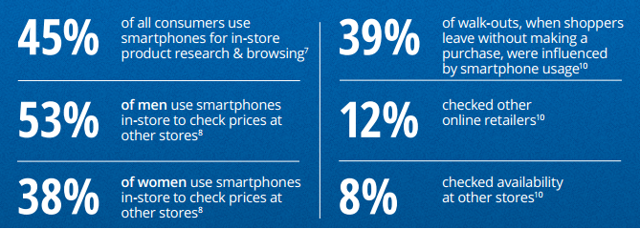
Remember a smart phone is a phone.
Make your phone number clickable so a customer can easily call you if they need more information about your product or service.
Almost half of all consumers use smartphones for in-store product research and browsing.
A ten-country study by management consulting firm Accenture found that 73% of mobile-powered shoppers preferred phones to retail clerks for basic assistance.
Links need to be thumb friendly.
Most people use their thumbs to navigate around on a smart phone and if your links aren't big enough to be clicked on with a thumb you need to reconsider.
f
t
in

Slide 11
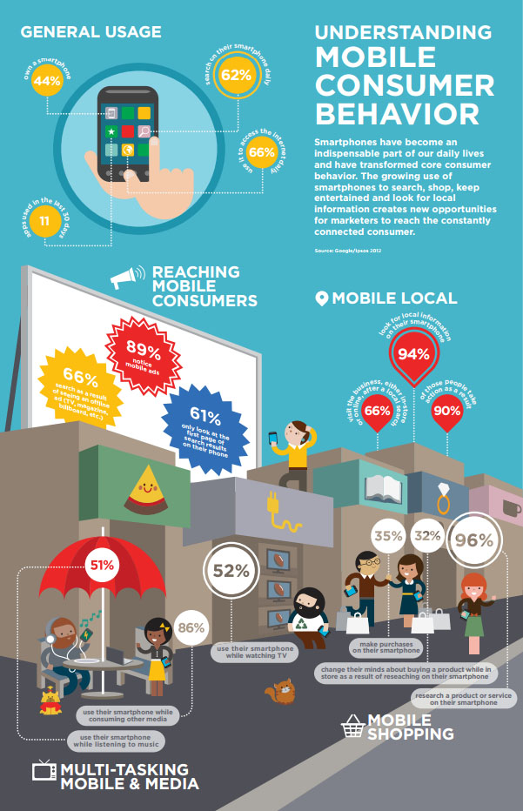
f
t
in

Slide 12

CHAPTER
4
Test Your Site

Slide 13

Test Your Site
“
I want an Oompa Loompa, and I want it NOW!
”
-Varuca Salt, Willie Wonka
Testing is necessary to ensure that the mobile experience is as flawless as possible. Much like the Character Varuca Salt in Willie Wonka and the Chocolate Factory, people are very time sensitive. If your site takes a long time to download users will leave. That becomes even
more important on a mobile device. You can’t always count on the user being connected to a broadband wireless network or having a 4G LTE data plan. There are many users and places where 3G is the best connection they are going to get. Make sure your site loads with reasonable speed and if not adjust images, scripts and content accordingly.
f
t
in

Slide 14
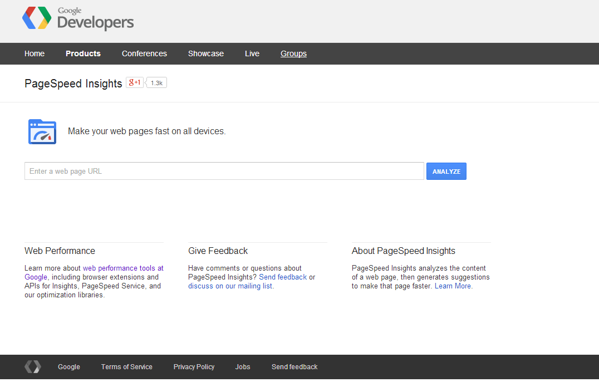
Just because your site looks great on your 10” Microsoft Surface Pro tablet doesn’t mean it will look as good on my 7” kindle, or my iPhone 4. You need to test your site on multiple devices and screen sizes.
Google has a great online tool for checking page load times, https://developers.google.com/speed/pagespeed/insights
Here is a link to Google Developer tools for testing mobile:
https://developers.google.com/chrome-developer-tools/docs/mobile-emulation#emulate-device-viewports
f
t
in

Slide 15

CHAPTER
5
Avoid Common Mistakes

Slide 16

Common Mistakes
Limited Content.-- Tailor your content, don't cripple it. Your customers will want to see a tailored experience based on the device they use - but they still want a complete experience. Make sure to design for mobile, rather than simply removing content from your desktop site.
Multiple Domains.-- Do not serve your mobile site from a different domain, e.g. example.com versus example.provider.com. Domains have brand identity, and have implications on search ranking, both typically built over years, and often with a lot of investment.
Pop-ups. --Pop-ups are generally a bad user experience. Instead, we recommend using a simple banner to promote your app inline with the page's content.
f
t
in

Slide 17
Common Mistakes
Unplayable videos.-- Many videos are not playable on smartphone devices. We recommend using HTML5 standard tags to include videos and avoid content in formats, such as Flash, that are not supported by all mobile devices.
Faulty redirects.-- If you do have an equivalent smartphone URL, make sure to configure the redirection so that users end up on the correct destination page.
Load Speed.-- Sites that load fast generally offer a better user experience. On mobile, users seem even more sensitive to speed and more likely to give up if the website doesn't load fast.
f
t
in

Slide 18

CHAPTER
6
Measure, Analyze and Adjust

Slide 19
Measure, Analyze, Adjust
Successful website owners have always measured and analyzed user behavior in order to optimize content and improve user engagement. The same principles apply to multi-device sites. Most successful businesses with multi-device websites analyze interactions across devices and continuously improve their web presence.
1
Understand how customers currently interact with your site
Analyze the traffic on your website to understand where your customers came from; what times they visit, what content they consume and especially what devices they use. A solid analysis will give you a good understanding of the status quo and will help you identify what areas to focus on.
Adapt to customer needs
An analysis of your current website might give you hints—e.g. what a smartphone user is looking for versus a desktop or a tablet. You might learn that prioritizing specific content on the mobile-friendly version improves conversion rates and reduces bounce rates. The idea is to tailor and rearrange content rather than removing it and offering a stripped down version of your website. Keeping the user in mind when creating device specific content is key to engaging site users and improving site stickiness.
2
f
t
in

Slide 20
TALK TO US
At Contensive, our mission is to help companies better manage their online ecosystems while saving time and money. That's why we're offering a free mobile assessment.
As part of your assessment, one of Contensive's development Specialists will evaluate your site and show you how you can get more traffic and leads by going mobile.
If you'd like this free mobile assessment, please click the link below.
There's no risk, no obligation, and no credit card required.
Click here
A Publication of

